Slide 1
COMS10003: Linear Algebra
Eigenvalues and Eigenvectors
Andrew Calway

Slide 2
Linear Transformations
eigenvalue
eigenvector

Slide 3
Eigenvalues and Eigenvectors
For matrix A, there may exist scalars and vectors s.t
For a given , there exists infinitely many eigenvectors in the same direction

Slide 4
Finding Eigenvalues
non-zero only exists if matrix
has no inverse – is singular

Slide 5
Characteristic Matrix

Slide 6
Inverse of 2x2 Matrix
For a 2x2 matrix its inverse is defined as
- known as the determinant
If determinant = 0
Singular, no inverse

Slide 7
Eigenvalues for 2x2 Matrices
Hence to find eigenvalues solve for in
characteristic equation
Quadratic in
two eigenvalues

Slide 8
Eigenvectors for 2x2 Matrices
Given eigenvalues and , solve for for each
NB: can only determine relative values of and
direction of

Slide 9
Determinant of 3x3 Matrix
For 3x3 matrix A and using row i
cofactor
minor matrix

Slide 10
Eigenvalues of 3x3 Matrix - Example

Slide 11
Independence of Eigenvectors
Non-zero eigenvectors corresponding to different eigenvalues of a matrix are linearly independent

Slide 12
Diagonalisation
Eigenvalues and eigenvectors of n x n matrix A
columns are eigenvectors of A

Slide 13
Powers of Matrices
We can use diagonalisation to efficiently compute powers of matrices

Slide 14
Principal Component Analysis
Dimensionality reduction – from 2-D → 1-D
Represent points
by x coordinate
Represent points
by projection onto line
Determine best line using PCA

Slide 15
Best Fitting Line
2-D points
Find unit vector such that
projections
Covariance
of 2-D points
Eigenvector of C corresponding to largest eigenvalue – principal axis

Slide 16
Principal Axes
Projections onto principal axes
Principal components
Eigenvectors of covariance matrix

Slide 17
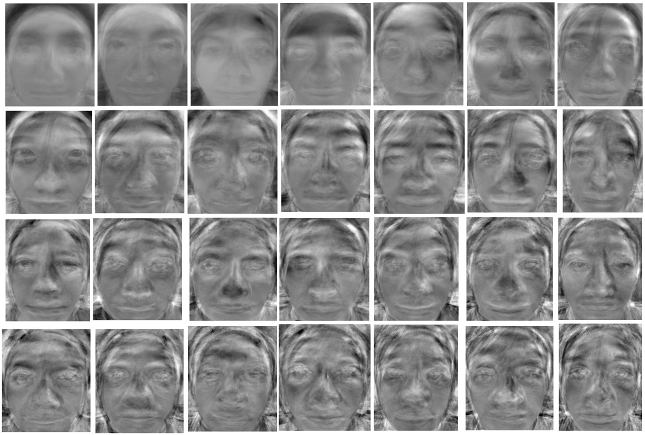
Eigenfaces

Slide 18
Pagerank
Web
pages
Page importance
Pagerank vector – eigenvector of transition matrix corresponding to eigenvalue with value 1

